Slide 1
Peer to Peer Lending Final Project
Justin Schneider, Anthony Frazier, James Edwards, Anna Hettermann

Slide 2

What is Peer to Peer Lending?
Peer to Peer lending is the practice of lending money to individuals or businesses through online services that match lenders directly with borrowers as opposed to more traditional bank loans.
Data provided by:

Slide 3
Data we received
2 large excel files with data from 2007-2011
One containing info on loans that were rejected/the people that had requested the loan
One containing info on loans that were accepted/the people that had requested the loan

Slide 4
Cleaning of the data
From Accepted Loans excel sheet:
Deleted a total of 88 columns
32 of columns were populated but had information that was not necessary for our visualization such as :
Member-Id
URL
Title
Sub-grade
Next payment date
The remaining 56 columns were more than 50% unpopulated rendering the data from those columns useless

Slide 5
Cleaning of the data cont’d
From Rejected Loans excel sheet:
Deleted only 1 column:
policy number

Slide 6
Problems we faced with data
More raw data for rejected loans
More total entries
Significantly more data types for accepted loans than rejected loans
More detailed data, but many less entries

Slide 7
Problems we faced with data cont’d
We chose to use the Recession as a critical point to demonstrate a ‘during vs after’ approach
Since we chose to use the Recession, had to make our own CSVs to use for visualization

Slide 8
Problems we faced with data cont’d
Not all of these practices are legal in all states. We had trouble with data for North Dakota, Maine, and West Virginia

Slide 9
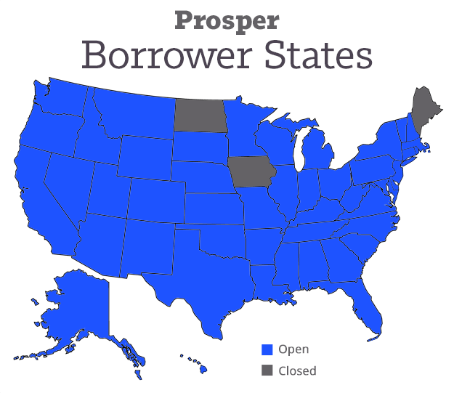
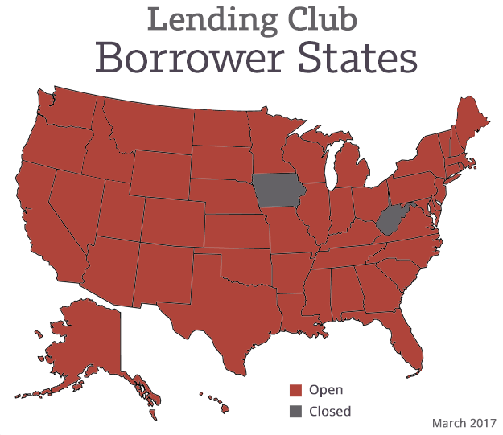
Problems we faced with data cont’d

Slide 10
Data Validation
Used choropleth map to represent data geographically
Which states were granted more of amount requested
Bar graphs to further demonstrate the states variation of debt to income and average interest rate

Slide 11
Questions visualization addresses:
How did the recession effect:
Average Loan funded amount
Average DTI (debt to income ratio of individual requesting loan)
Average Interest Rate

Slide 12
DEMO

Slide 13
Conclusions Drawn:
Average interest rate much higher and more varied during the recession vs after the recession
Average DTI lower after recession
Average amount funded is much higher after recession – people had more spending money to invest in p2p loans

Slide 14
Questions?

